Slide 1
Linked Lists

Slide 2
LIMITATIONS OF ARRAYS
Arrays are simple to understand and elements of an array are easily accessible
But arrays have some limitations.
Arrays have a fixed dimension.
Once the size of an array is decided it can not be increased or decreased during program execution.

Slide 3
LIMITATIONS OF ARRAYS
Array elements are always stored in contiguous memory locations.
Operations like insertion or deletion of the array are pretty tedious.
To over come this limitations we use linked list.

Slide 4
LINKED LISTS
Linked list is a linear data structure.
Linked list is a collection of elements called nodes.
Each node contains two parts. they are data part and link part.
Each node contains two parts, i.e. DATA part and LINK part.
The data contains elements and
Link contains address of another node.
Node
data
link

Slide 5
Linked List
A
B
C
∅
Head
A linked list is a series of connected nodes
Each node contains at least
A piece of data (any type)
Pointer to the next node in the list
Head: pointer to the first node
The last node points to NULL
node
A
data
pointer

Slide 6
14
100
30
400
42
N
200
100
400
The above figure shows the example of marks obtained by different students can be stored in a linked list
Here N-stands for NULL.
Null indicates the end of the node.

Slide 7
Arrays Vs Linked Lists
Arrays | Linked list
Fixed size: Resizing is expensive | Dynamic size
Insertions and Deletions are inefficient: Elements are usually shifted | Insertions and Deletions are efficient: No shifting
Random access i.e., efficient indexing | No random access → Not suitable for operations requiring accessing elements by index such as sorting
No memory waste if the array is full or almost full; otherwise may result in much memory waste. | Since memory is allocated dynamically(acc. to our need) there is no waste of memory.
Sequential access is faster [Reason: Elements in contiguous memory locations] | Sequential access is slow [Reason: Elements not in contiguous memory locations]

Slide 8
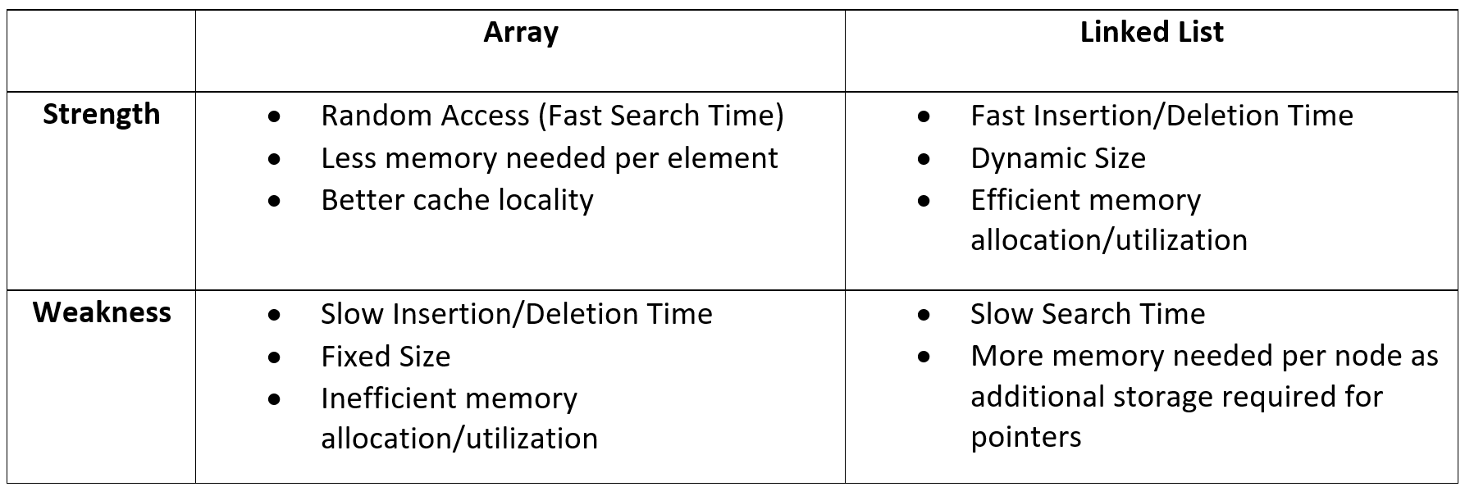
Arrays vs Linked List (Summary)

Slide 9
Types of lists
There are two basic types of linked list
Singly Linked list
Doubly linked list

Slide 10
Singly Linked List
Each node has only one link part
Each link part contains the address of the next node in the list
Link part of the last node contains NULL value which signifies the end of the node

Slide 11









Schematic Representation
Here, it is a singly-linked list (SLL):
head
a
b
c
d
Each node contains a value(data) and a pointer, which points to the next node of the list
head is the header pointer which points to the first node of the list

Slide 12
Basic Operations on a list
Creating a List
Traversing in List
Inserting an element in a list
Deleting an element from a list
Searching a list
Reversing a list

Slide 13

Creating a node
struct node{
int data; node*next;
}*start;
start=NULL ;
// A simple node of a linked list
//start points at the first node
initialised to NULL at beginning

Slide 14
Traversal Singly Linked Lists
ALGORITHM FOR TRAVERSING A LINKED LIST
Step 1: [INITIALIZE] SET PTR = START
Step 2: Repeat Steps 3 and 4 while PTR != NULL
Step 3: Apply Process to PTR->DATA
Step 4: SET PTR = PTR->NEXT
[END OF LOOP]
Step 5: EXIT
void display(struct node *ptr)
{
while(ptr != NULL)
{
printf("%d ", ptr->data); // process
ptr = ptr->next;
}
}

Slide 15
Inserting the node in a SLL
There are 3 cases here:-
Insertion at the beginning
Insertion at the end
Insertion after a particular node

Slide 16
Insertion at the beginning
There are two steps to be followed:-
Make the next pointer of the node point towards the first node of the list
Make the start pointer point towards this new node
If the list is empty simply make the start pointer point towards the new node;

Slide 17

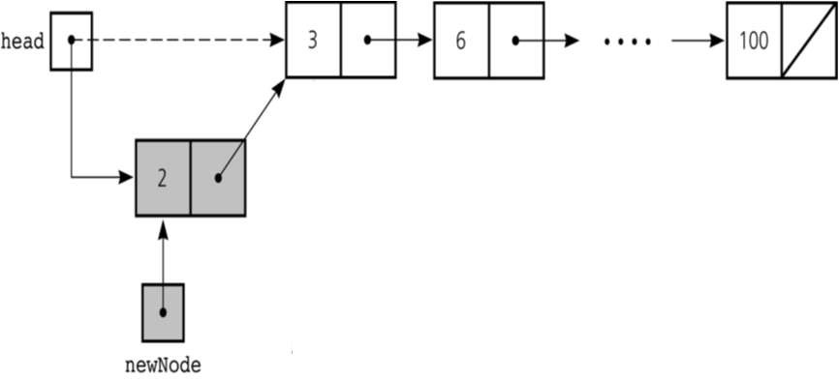

Slide 18
Insertion at the beginning
1
7
3
4
2
6
5
X
START
9
1
7
3
4
2
6
5
X
START
ALGORITHM: INSERT A NEW NODE IN THE BEGINNING OF THE LINKED LIST
Step 1: IF AVAIL = NULL, then
Write OVERFLOW
Go to Step 7
[END OF IF]
Step 2: SET New_Node = AVAIL
Step 3: SET AVAIL = AVAIL->NEXT
Step 4: SET New_Node->DATA = VAL
Step 5: SET New_Node->Next = START
Step 6: SET START = New_Node
Step 7: EXIT

Slide 19
void insert_beg(node* p)
{
node* temp;
if(start==NULL)
{
start=p;
//if the list is empty
Printf(”\nNode inserted successfully at the beginning”);
}
else {
temp=start; start=p;
p->next=temp; //making new node point at
the first node of the list
}
}

Slide 20
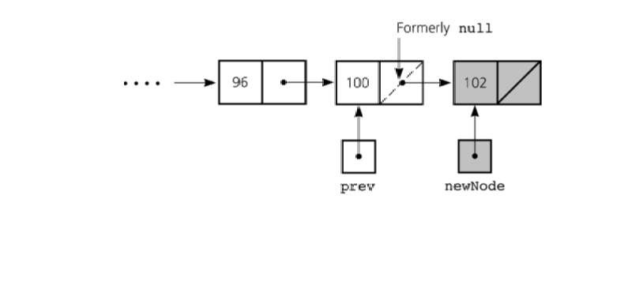
Inserting at the end
Here we simply need to make the next pointer of the last node point to the new node

Slide 21
Inserting at the end
ALGORITHM TO INSERT A NEW NODE AT THE END OF THE LINKED LIST
Step 1: IF AVAIL = NULL, then
Write OVERFLOW
Go to Step 10
[END OF IF]
Step 2: SET New_Node = AVAIL
Step 3: SET AVAIL = AVAIL->NEXT
Step 4: SET New_Node->DATA = VAL
Step 5: SET New_Node->Next = NULL
Step 6: SET PTR = START
Step 7: Repeat Step 8 while PTR->NEXT != NULL
Step 8: SET PTR = PTR ->NEXT
[END OF LOOP]
Step 9: SET PTR->NEXT = New_Node
Step 10: EXIT

Slide 22
Inserting at the end
1
7
3
4
2
6
5
X
START, PTR
1
7
3
4
2
6
5
9
X
START

Slide 23
void insert_end(node* p)
{
node *q=start;
if(start==NULL)
{
start=p;
Printf(”\nNode inserted successfully at the end…!!!\n”);
}
else{
while(q->link!=NULL) q=q->link;
q->next=p;
}
}

Slide 24
Inserting after an element
Here we again need to do 2 steps :-
Make the next pointer of the node to be inserted point to the next node of the node after which you want to insert the node
Make the next pointer of the node after which the node is to be inserted, point to the node to be inserted

Slide 25
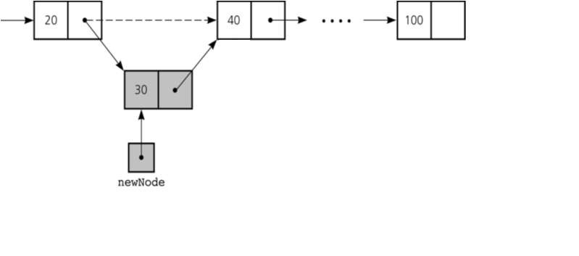

Slide 26
Inserting after an element
ALGORITHM TO INSERT A NEW NODE AFTER A NODE THAT HAS VALUE NUM
Step 1: IF AVAIL = NULL, then
Write OVERFLOW
Go to Step 12
[END OF IF]
Step 2: SET New_Node = AVAIL
Step 3: SET AVAIL = AVAIL->NEXT
Step 4: SET New_Node->DATA = VAL
Step 5: SET PTR = START
Step 6: SET PREPTR = PTR
Step 7: Repeat Steps 8 and 9 while PREPTR->DATA != NUM
Step 8: SET PREPTR = PTR
Step 9: SET PTR = PTR->NEXT
[END OF LOOP]
Step 10: PREPTR->NEXT = New_Node
Step 11: SET New_Node->NEXT = PTR
Step 12: EXIT

Slide 27
void insert_after(int c,node* p)
{
node* q; q=start;
for(int i=1;i<c;i++)
{
q=q->link;
if(q==NULL)
printf(”Less than and nodes in the list…!!!”);
}
p->link=q->link; q->link=p;
printf(”\nNode inserted successfully”);
}

Slide 28
Deleting a node in SLL
Here also we have three cases:-
Deleting the first node
Deleting the last node
Deleting the intermediate node

Slide 29


Deleting the first node
Here we apply 2 steps:-
Making the start pointer point towards the 2nd node
Deleting the first node using delete keyword
start
one
two
three

Slide 30
void del_first()
{
if(start==NULL) printf(”\nError……List is empty\n”); else
{
node* temp=start; start=temp->link; delete temp;
Printf{”\nFirst node deleted successfully….!!!”);
}
}

Slide 31
Deleting the first node
Algorithm to delete the first node from the linked list
Step 1: IF START = NULL, then
Write UNDERFLOW
Go to Step 5
[END OF IF]
Step 2: SET PTR = START
Step 3: SET START = START->NEXT
Step 4: FREE PTR
Step 5: EXIT
1
7
3
4
2
6
5
X
START
7
3
4
2
6
5
X
START

Slide 32

Deleting the last node
Here we apply 2 steps:-
Making the second last node’s next pointer point to NULL
Deleting the last node via delete keyword
start
45
85
node3

Slide 33
Deleting the last node
ALGORITHM TO DELETE THE LAST NODE OF THE LINKED LIST
Step 1: IF START = NULL, then
Write UNDERFLOW
Go to Step 8
[END OF IF]
Step 2: SET PTR = START
Step 3: Repeat Steps 4 and 5 while PTR->NEXT != NULL
Step 4: SET PREPTR = PTR
Step 5: SET PTR = PTR->NEXT
[END OF LOOP]
Step 6: SET PREPTR->NEXT = NULL
Step 7: FREE PTR
Step 8: EXIT
1
7
3
4
2
6
5
X
START, PREPTR, PTR
1
7
3
4
2
6
X
5
X
START
PREPTR PTR

Slide 34

void del_last()
{
if(start==NULL) printf(”\nError….List is empty”); else
{
node* q=start;
while(q->link->link!=NULL) q=q->link;
node* temp=q->link; q->link=NULL; delete temp;
Printf(”\nDeleted successfully…”);
}
}
}

Slide 35

Deleting a particular node
Here we make the next pointer of the node previous to the node being deleted ,point to the successor node of the node to be deleted and then delete the node using delete keyword
node1
node3
node2
To be deleted

Slide 36
Deleting a particular node
ALGORITHM TO DELETE THE NODE AFTER A GIVEN NODE FROM THE LINKED LIST
Step 1: IF START = NULL, then
Write UNDERFLOW
Go to Step 10
[END OF IF]
Step 2: SET PTR = START
Step 3: SET PREPTR = PTR
Step 4: Repeat Step 5 and 6 while PRETR->DATA != NUM
Step 5: SET PREPTR = PTR
Step 6: SET PTR = PTR->NEXT
[END OF LOOP]
Step7: SET TEMP = PTR
Step 8: SET PREPTR->NEXT = TEMP->NEXT
Step 9: FREE TEMP
Step 10: EXIT

Slide 37
Deleting a particular node
1
7
3
4
2
6
5
X
START, PREPTR, PTR
1
7
3
4
2
6
5
X
START
PREPTR PTR
1
7
3
4
2
6
5
X
START
1
7
3
4
6
5
X

Slide 38
void del(int c)
{
node* q=start;
for(int i=2;i<c;i++)
{
q=q->link;
if(q==NULL)
Printf(”\nNode not found\n”);
}
if(i==c)
{
node* p=q->link; q->link=p->link; delete p;
//node to be deleted
//disconnecting the node p
Printf(“Deleted Successfully”);
}
}

Slide 39
Searching in a SLL
Searching involves finding the required element in the given list
We can use various techniques of searching like linear search or binary search where binary search is more efficient in case of Arrays
But in case of linked list since random access is not available it would become complex to do binary search in it
We can perform simple linear search traversal

Slide 40
Searching a Linked List
ALGORITHM TO SEARCH A LINKED LIST
Step 1: [INITIALIZE] SET PTR = START
Step 2: Repeat Step 3 while PTR != NULL
Step 3: IF VAL = PTR->DATA
SET POS = PTR
Go To Step 5
ELSE
SET PTR = PTR->NEXT
[END OF IF]
[END OF LOOP]
Step 4: SET POS = NULL // not found
Step 5: EXIT // found, output POS
struct node* search(struct node *ptr, int num)
{
while((ptr != NULL) && (ptr->data != num))
{
ptr = ptr->next;
}
return ptr;
}
// call example, search(START, 4)

Slide 41
In linear search each node is traversed till the data in
the node matches with the required value
void search(int x)
{
node*temp=start; while(temp!=NULL)
{
if(temp->data==x)
{
Printf(“FOUND %d”,temp->data); break;
}
temp=temp->next;
}
}

Slide 42
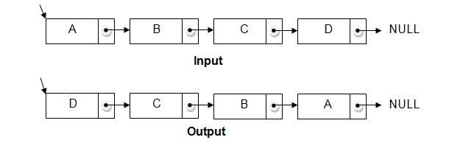
Reversing a linked list
We can reverse a linked list by reversing the direction of the links between 2 nodes

Slide 43
We make use of 3 structure pointers say p,q,r
At any instant q will point to the node next to p and r will point to the node next to q
Head
P
pq
qr
NULL
NULL
For next iteration p=q and q=r
At the end we will change head to the last node

Slide 44
Code
void reverse()
{
node*p,*q,*r; if(start==NULL)
{
Printf("\nList is empty\n");
return;
}
p=start; q=p->link;
p->link=NULL;
while(q!=NULL)
{
r=q->link; q->link=p; p=q;
q=r;
}
start=p;
Printf("\nReversed successfully");
}

Slide 45
Circular linked list
In a circular linked list, the last node contains a pointer to the first node of the list.
We can have a circular singly listed list as well as circular doubly linked list.
While traversing a circular linked list, we can begin at any node and traverse the list in any direction forward or backward until we reach the same node where we had started.
Thus, a circular linked list has no beginning and no ending.
START
1
2
3
4
5
6
7

Slide 46
Inserting a node in CSLL
Here also we have three cases:-
Inserting the first node
Inserting the last node
Inserting the intermediate node

Slide 47
Circular linked list
Algorithm to insert a new node in the beginning of circular the linked list
Step 1: IF AVAIL = NULL, then
Write OVERFLOW
Go to Step 7
[END OF IF]
Step 2: SET New_Node = AVAIL
Step 3: SET AVAIL = AVAIL->NEXT
Step 4: SET New_Node->DATA = VAL
Step 5: SET PTR = START
Step 6: Repeat Step 7 while PTR->NEXT != START
Step 7: PTR = PTR->NEXT
Step 8: SET New_Node->Next = START
Step 8: SET PTR->NEXT = New_Node
Step 6: SET START = New_Node
Step 7: EXIT

Slide 48
Circular linked list
1
7
3
4
2
6
5
START, PTR
1
7
3
4
2
6
5
START
PTR
9
1
7
3
4
2
6
5
START

Slide 49
Circular linked list
Algorithm to insert a new node at the end of the circular linked list
Step 1: IF AVAIL = NULL, then
Write OVERFLOW
Go to Step 7
[END OF IF]
Step 2: SET New_Node = AVAIL
Step 3: SET AVAIL = AVAIL->NEXT
Step 4: SET New_Node->DATA = VAL
Step 5: SET New_Node->Next = START
Step 6: SET PTR = START
Step 7: Repeat Step 8 while PTR->NEXT != START
Step 8: SET PTR = PTR ->NEXT
[END OF LOOP]
Step 9: SET PTR ->NEXT = New_Node
Step 10: EXIT

Slide 50
Circular linked list
1
7
3
4
2
6
5
START, PTR
1
7
3
4
2
6
5
9
PTR
START

Slide 51
Circular linked list
Algorithm to insert a new node after a node that has value NUM
Step 1: IF AVAIL = NULL, then
Write OVERFLOW
Go to Step 12
[END OF IF]
Step 2: SET New_Node = AVAIL
Step 3: SET AVAIL = AVAIL->NEXT
Step 4: SET New_Node->DATA = VAL
Step 5: SET PTR = START
Step 6: SET PREPTR = PTR
Step 7: Repeat Step 8 and 9 while PTR->DATA != NUM
Step 8: SET PREPTR = PTR
Step 9: SET PTR = PTR->NEXT
[END OF LOOP]
Step 10: PREPTR->NEXT = New_Node
Step 11: SET New_Node->NEXT = PTR
Step 12: EXIT

Slide 52
Deleting a node in CSLL
Here also we have three cases:-
Deleting the first node
Deleting the last node
Deleting the intermediate node

Slide 53
Circular linked list
Algorithm to delete the first node from the circular linked list
Step 1: IF START = NULL, then
Write UNDERFLOW
Go to Step 8
[END OF IF]
Step 2: SET PTR = START
Step 3: Repeat Step 4 while PTR->NEXT != START
Step 4: SET PTR = PTR->NEXT
[END OF IF]
Step 5: SET PTR->NEXT = START->NEXT
Step 6: FREE START
Step 7: SET START = PTR->NEXT
Step 8: EXIT

Slide 54
Circular linked list
1
7
3
4
2
6
5
START, PTR
1
7
3
4
2
6
5
PTR
START
7
3
4
2
6
5
START

Slide 55
Circular linked list
Algorithm to delete the last node of the circular linked list
Step 1: IF START = NULL, then
Write UNDERFLOW
Go to Step 8
[END OF IF]
Step 2: SET PTR = START
Step 3: Repeat Step 4 while PTR->NEXT != START
Step 4: SET PREPTR = PTR
Step 5: SET PTR = PTR->NEXT
[END OF LOOP]
Step 6: SET PREPTR->NEXT = START
Step 7: FREE PTR
Step 8: EXIT

Slide 56
Circular linked list
1
7
3
4
2
6
5
START, PREPTR, PTR
1
7
3
4
2
6
5
PREPTR
PTR
START
1
7
3
4
2
6
START

Slide 57
Circular linked list
Algorithm to delete the node after a given node from the circular linked list
Step 1: IF START = NULL, then
Write UNDERFLOW
Go to Step 9
[END OF IF]
Step 2: SET PTR = START
Step 3: SET PREPTR = PTR
Step 4: Repeat Step 5 and 6 while PREPTR->DATA != NUM
Step 5: SET PREPTR = PTR
Step 6: SET PTR = PTR->NEXT
[END OF LOOP]
Step 7: SET PREPTR->NEXT = PTR->NEXT
Step 8: FREE PTR
Step 9: EXIT

Slide 58
Circular linked list
1
7
3
4
2
6
5
START, PREPTR, PTR
1
7
3
4
2
6
5
START
PREPTR PTR
1
7
3
4
6
5
START

Slide 59
Doubly Circular Linked List
1. Doubly circular linked list is a linked data structure that consists of a set of sequentially linked records called nodes.
2 .
Each node contains three fields ::
-: one is data part which contain data only.
-:two other field is links part that are point or references to the previous or to the next node in the sequence of nodes.
3.
The beginning and ending nodes' previous and next links, respectively, point to some kind of terminator, typically a sentinel node or null to facilitate traversal of the list.

Slide 60

NODE
previous | data | next
A
B
C
NULL | 11 | 786
200
656
400
786 | 777 | NULL
200
786
400
A doubly linked list contain three fields: an integer value, the link to the next node, and the link to the previous node.

Slide 61
DLL’s compared to SLL’s
Advantages:
Can be traversed in either direction (may be essential for some programs)
Some operations, such as deletion and inserting before a node, become easier
Disadvantages:
Requires more space
List manipulations are slower (because more links must be changed)
Greater chance of having bugs (because more links must be manipulated)

Slide 62
Structure of DLL
struct node
{
int data; node*next; node*previous;
};
//holds the address of previous node
previous.
.Data
.next
inf

Slide 63
Inserting a node in DLL
Here also we have three cases:-
Inserting the first node
Inserting the last node
Inserting the intermediate node

Slide 64


Inserting at beginning

Slide 65
Inserting at beginning
Algorithm to insert a new node in the beginning of the doubly linked list
Step 1: IF AVAIL = NULL, then
Write OVERFLOW
Go to Step 8
[END OF IF]
Step 2: SET New_Node = AVAIL
Step 3: SET AVAIL = AVAIL->NEXT
Step 4: SET New_Node->DATA = VAL
Step 5: SET New_Node->PREV = NULL
Step 6: SET New_Node->Next = START
Step 7: SET START = New_Node
Step 8: EXIT

Slide 66
Inserting at beginning
X
1
7
3
4
2
X
START
2
X
X
9
1
7
3
4
START

Slide 67
void insert_beg(node *p)
{
if(start==NULL)
{
start=p;
Printf("\nNode inserted successfully at the beginning\m");
}
else
{
node* temp=start;
start=p;
temp->previous=p; new node
p->next=temp;
1st node
//making 1st node’s previous point to the
//making next of the new node point to the
Printf("\nNode inserted successfully at the beginning\n");
}

Slide 68
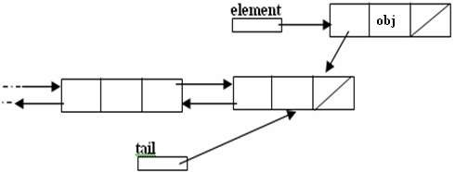
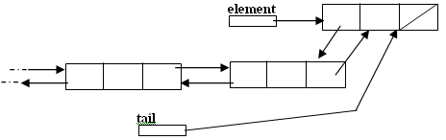
Inserting at the end

Slide 69
Inserting at the end
Algorithm to insert a new node at the end of the doubly linked list
Step 1: IF AVAIL = NULL, then
Write OVERFLOW
Go to Step 11
[END OF IF]
Step 2: SET New_Node = AVAIL
Step 3: SET AVAIL = AVAIL->NEXT
Step 4: SET New_Node->DATA = VAL
Step 5: SET New_Node->Next = NULL
Step 6: SET PTR = START
Step 7: Repeat Step 8 while PTR->NEXT != NULL
Step 8: SET PTR = PTR->NEXT
[END OF LOOP]
Step 9: SET PTR->NEXT = New_Node
Step 10: New_Node->PREV = PTR
Step 11: EXIT

Slide 70
Inserting at the end
X
1
7
3
4
2
X
START, PTR
X
1
7
3
4
2
9
X
PTR

Slide 71
void insert_end(node* p)
{
if(start==NULL)
{
start=p;
Printf("\nNode inserted successfully at the end");
}
else
{
node* temp=start; while(temp->next!=NULL)
{
temp=temp->next;
}
temp->next=p;
p->previous=temp;
Printf("\nNode inserted successfully at the end\n");
}
}

Slide 72
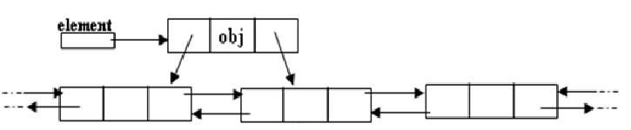
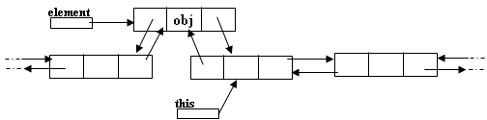
Inserting after a node
Making next and previous pointer of the node to be inserted point accordingly
Adjusting the next and previous pointers of the nodes b/w which the new node accordingly

Slide 73
Inserting after a node
Algorithm to insert a new node after a node that has value NUM
Step 1: IF AVAIL = NULL, then
Write OVERFLOW
Go to Step 11
[END OF IF]
Step 2: SET New_Node = AVAIL
Step 3: SET AVAIL = AVAIL->NEXT
Step 4: SET New_Node->DATA = VAL
Step 5: SET PTR = START
Step 6: Repeat Step 8 while PTR->DATA != NUM
Step 7: SET PTR = PTR->NEXT
[END OF LOOP]
Step 8: New_Node->NEXT = PTR->NEXT
Step 9: SET New_Node->PREV = PTR
Step 10: SET PTR->NEXT = New_Node
Step 10: SET PTR->NEXT->PREV = New_Node
Step 11: EXIT

Slide 74
Inserting after a node
X
1
7
3
4
2
X
START, PTR
X
1
7
3
4
2
X
START
PTR
9
X
1
7
3
9
4
2
X
START

Slide 75
void insert_after(int c,node* p)
{
temp=start;
for(int i=1;i<c-1;i++)
{
temp=temp->next;
}
p->next=temp->next; temp->next->previous=p; temp->next=p;
p->previous=temp; printf("\nInserted successfully");
}

Slide 76
Deleting a node in DLL
Here also we have three cases:-
Deleting the first node
Deleting the last node
Deleting the intermediate node

Slide 77


Deleting a node
Node deletion from a DLL involves changing two links
In this example,we will delete node b
myDLL
a
b
c
We don’t have to do anything about the links in node b
Garbage collection will take care of deleted nodes
Deletion of the first node or the last node is a special case

Slide 78
Deleting a node
Algorithm to delete the first node from the doubly linked list
Step 1: IF START = NULL, then
Write UNDERFLOW
Go to Step 6
[END OF IF]
Step 2: SET PTR = START
Step 3: SET START = START->NEXT
Step 4: SET START->PREV = NULL
Step 5: FREE PTR
Step 6: EXIT
X
1
7
3
4
2
X
START, PTR
7
3
4
2
X

Slide 79
void del_at(int c)
{
node*s=start;
{
for(int i=1;i<c-1;i++)
{
s=s->next;
}
node* p=s->next; s->next=p->next;
p->next->previous=s; delete p;
printf("\nNode number and deleted successfully");
}
}
}

Slide 80
Deleting the first node
Algorithm to delete the first node from the doubly linked list
Step 1: IF START = NULL, then
Write UNDERFLOW
Go to Step 6
[END OF IF]
Step 2: SET PTR = START
Step 3: SET START = START->NEXT
Step 4: SET START->PREV = NULL
Step 5: FREE PTR
Step 6: EXIT
X
1
7
3
4
2
X
START, PTR
7
3
4
2
X

Slide 81
Deleting the last node
Algorithm to delete the last node of the doubly linked list
Step 1: IF START = NULL, then
Write UNDERFLOW
Go to Step 7
[END OF IF]
Step 2: SET PTR = START
Step 3: Repeat Step 4 while PTR->NEXT != NULL
Step 4: SET PTR = PTR->NEXT
[END OF LOOP]
Step 5: SET PTR->PREV->NEXT = NULL
Step 6: FREE PTR
Step 7: EXIT

Slide 82
Deleting the last node
X
1
3
5
7
8
91
X
START, PTR
X
1
3
5
7
8
91
X
START
PTR
X
1
3
5
7
8
X
START

Slide 83
Deleting the node after a specific location
Algorithm to delete the node after a given node from the doubly linked list
Step 1: IF START = NULL, then
Write UNDERFLOW
Go to Step 9
[END OF IF]
Step 2: SET PTR = START
Step 3: Repeat Step 4 while PTR->DATA != NUM
Step 4: SET PTR = PTR->NEXT
[END OF LOOP]
Step 5: SET TEMP = PTR->NEXT
Step 6: SET PTR->NEXT = TEMP->NEXT
Step 7: SET TEMP->NEXT->PREV = PTR
Step 8: FREE TEMP
Step 9: EXIT

Slide 84
Deleting the node after a specific location
X
1
3
4
7
8
91
X
START, PTR
X
1
3
4
7
8
91
X
START
PTR
X
1
3
4
8
9
X
START

Slide 85
Circular Doubly Linked List
A circular doubly linked list or a circular two way linked list is a more complex type of linked list which contains a pointer to the next as well as previous node in the sequence.
The difference between a doubly linked and a circular doubly linked list is same as that exists between a singly linked list and a circular linked list.
The circular doubly linked list does not contain NULL in the previous field of the first node and the next field of the last node.

Slide 86
Circular Doubly Linked List
Rather, the next field of the last node stores the address of the first node of the list, i.e; START.
Similarly, the previous field of the first field stores the address of the last node.

Slide 87
Circular Doubly Linked List
Since a circular doubly linked list contains three parts in its structure, it calls for more space per node and for more expensive basic operations.
However, it provides the ease to manipulate the elements of the list as it maintains pointers to nodes in both the directions . The main advantage of using a circular doubly linked list is that it makes searches twice as efficient.
START
1
1
2
3
4

Slide 88
Inserting a node in CDLL
Here also we have three cases:-
Inserting the first node
Inserting the last node
Inserting the intermediate node

Slide 89
Circular Doubly Linked List
Algorithm to insert a new node in the beginning of the circular doubly linked list
Step 1: IF AVAIL = NULL, then
Write OVERFLOW
Go to Step 12
[END OF IF]
Step 2: SET New_Node = AVAIL
Step 3: SET AVAIL = AVAIL->NEXT
Step 4: SET New_Node->DATA = VAL
Step 6: SET START->PREV->NEXT = new_node;
Step 7: SET New_Node->PREV = START->PREV;
Step 8: SET START->PREV= new_Node;
Step 9: SET new_node->next = START;
Step 10: SET START = New_Node
Step 11: EXIT

Slide 90
Circular Doubly Linked List
Insert a new node in the beginning
1
7
3
4
2
START
9
1
7
3
4
2
START

Slide 91
Insertion at the END in CDLL
Algorithm to insert a new node at the end of the circular doubly linked list
Step 1: IF AVAIL = NULL, then
Write OVERFLOW
Go to Step 11
[END OF IF]
Step 2: SET New_Node = AVAIL
Step 3: SET AVAIL = AVAIL->NEXT
Step 4: SET New_Node->DATA = VAL
Step 5: SET New_Node->Next = START
Step 6: SET New_Node->PREV = START->PREV
Step 7: SET START->PRE->NEXT=New_Node
Step 8: SET START->PREV= New_Node
Step 7: EXIT
1
7
3
4
2
START
1
7
3
4
2
9
START

Slide 92
Circular Doubly Linked List
Algorithm to insert a new node after a node that has value NUM
Step 1: IF AVAIL = NULL, then
Write OVERFLOW
Go to Step 11
[END OF IF]
Step 2: SET New_Node = AVAIL
Step 3: SET AVAIL = AVAIL->NEXT
Step 4: SET New_Node->DATA = VAL
Step 5: SET PTR = START
Step 6: Repeat Step 8 while PTR->DATA != NUM
Step 7: SET PTR = PTR->NEXT
[END OF LOOP]
Step 8: New_Node->NEXT = PTR->NEXT
Step 9: SET PTR->NEXT->PREV = New_Node
Step 9: SET New_Node->PREV = PTR
Step 10: SET PTR->NEXT = New_Node
Step 11: EXIT

Slide 93
Circular Doubly Linked List
Algorithm to insert a new node after a node
1
7
3
4
2
START, PTR
1
7
3
4
2
PTR
START
9
1
7
3
9
4
2
START

Slide 94
Deleting a node in DLL
Here also we have three cases:-
Deleting the first node
Deleting the last node
Deleting the intermediate node

Slide 95
Circular Doubly Linked List
Algorithm to delete the first node from the circular doubly linked list
Step 1: IF START = NULL, then
Write UNDERFLOW
Go to Step 8
[END OF IF]
Step 2: SET PTR = START
Step 3: SET PTR->PREV=>NEXT= PTR->NEXT
Step 4: SET PTR->NEXT->PREV = PTR->PREV
Step 5: SET START = START->NEXT
Step 6: FREE PTR
Step 7: EXIT
1
3
5
7
8
91
START, PTR
3
5
7
8
91
START

Slide 96
Circular Doubly Linked List
Algorithm to delete the last node of the circular doubly linked list
Step 1: IF START = NULL, then
Write UNDERFLOW
Go to Step 8
[END OF IF]
Step 2: SET PTR = START->PREV
Step 5: SET PTR->PREV->NEXT = START
Step 6: SET START->PREV = PTR->PREV
Step 7: FREE PTR
Step 8: EXIT
1
3
5
7
8
91
START
PTR
X
1
3
5
7
8
START

Slide 97
Circular Doubly Linked List
Algorithm to delete the node after a given node from the circular doubly linked list
Step 1: IF START = NULL, then
Write UNDERFLOW
Go to Step 9
[END OF IF]
Step 2: SET PTR = START
Step 3: Repeat Step 4 while PTR->DATA != NUM
Step 4: SET PTR = PTR->NEXT
[END OF LOOP]
Step 5: SET TEMP = PTR->NEXT
Step 6: SET PTR->NEXT = TEMP->NEXT
Step 7: SET TEMP->NEXT->PREV = PTR
Step 8: FREE TEMP
Step 9: EXIT

Slide 98
Circular Doubly Linked List
1
3
5
7
8
91
START
1
3
5
7
8
91
START
PTR
1
3
4
8
9
START

Slide 99
Circular Doubly Linked List
A header linked list is a special type of linked list which contains a header node at the beginning of the list.
So, in a header linked list START will not point to the first node of the list but START will contain the address of the header node.
There are basically two variants of a header linked list-
Grounded header linked list which stores NULL in the next field of the last node
Circular header linked list which stores the address of the header node in the next field of the last node. Here, the header node will denote the end of the list.

Slide 100
Circular Doubly Linked List
Header Node
1
2
3
4
5
6
X
START
Header Node
1
2
3
4
5
6
START

Slide 101
Circular Doubly Linked List
Algorithm to traverse a Circular Header Linked List
Step 1: SET PTR = START->NEXT
Step 2: Repeat Steps 3 and 4 while PTR != START
Step 3: Apply PROCESS to PTR->DATA
Step 4: SET PTR = PTR->NEXT
[END OF LOOP]
Step 5: EXIT

Slide 102
APPLICATIONS OF LINKED LIST
Applications that have an MRU (Most Recently Used) list (a linked list of file names)
The cache in your browser that allows you to hit the BACK button (a linked list of URLs)
Undo functionality in Photoshop or Word (a linked list of state)
A stack, hash table, and binary tree can be implemented using a doubly linked list.

Slide 103
Polynomials
Array Implementation:
p1(x) = 8x³ + 3x² + 2x + 6
p2(x) = 23x⁴ + 18x - 3
p1(x)
p2(x)
6 | 2 | 3 | 8
-3 | 18 | 0 | 0 | 23
0
2
0
2
4
Index represents exponents

Slide 104
This is why arrays aren’t good to represent polynomials:
p3(x) = 16x²¹ - 3x⁵ + 2x + 6
6 | 2 | 0 | 0 | -3 | 0 | ………… | 0 | 16
WASTE OF SPACE!

Slide 105
Advantages of using an Array:
Only good for non-sparse polynomials.
Ease of storage and retrieval.
Disadvantages of using an Array:
Have to allocate array size ahead of time.
Huge array size required for sparse polynomials.
Waste of space and runtime.

Slide 106

Polynomial Representation
Linked list Implementation:
p1(x) = 23x⁹ + 18x⁷ + 41x⁶ + 163x⁴ + 3
p2(x) = 4x⁶ + 10x⁴ + 12x + 8
P1
23
9
18
7
41
6
18
7
3
0
TAIL (contains pointer)
P2
4
6
10
4
12
1
8
0
NODE (contains coefficient & exponent)

Slide 107
Advantages of using a Linked list:
save space (don’t have to worry about sparse polynomials) and easy to maintain
don’t need to allocate list size and can declare nodes (terms) only as needed
Disadvantages of using a Linked list :
can’t go backwards through the list
can’t jump to the beginning of the list from the end.

Slide 108


Polynomials
A(x)
^{e}m 1
a_{m 1} x a_{m}
^{e}m 2 ^{e}0
₂ x ... a₀ x
Representation
struct polynode {
int coef;
int exp;
struct polynode * next;
};
typedef struct polynode *polyptr;
coef | exp | next

Slide 109
Adding polynomials using a Linked list representation: (storing the result in p3)
To do this, we have to break the process down to cases:
Case 1: exponent of p1 > exponent of p2
Copy node of p1 to end of p3. [go to next node]
Case 2: exponent of p1 < exponent of p2
Copy node of p2 to end of p3. [go to next node]

Slide 110
Case 3: exponent of p1 = exponent of p2
Create a new node in p3 with the same exponent and with the sum of the coefficients of p1 and p2.

Slide 111



Example
_{3x}14
a
2x⁸ 1
a
3
14
2
8
1 | 0 | null
b
b
_{8x}14
_{3x}10
10x⁶
8
14
-3
10
10 | 6 | null

Slide 112
Adding Polynomials
3 14
2 8
-3 10
1 0
10 6
a
8 14
b
11 14
a->expon == b->expon
d
3 14
2 8
-3 10
1 0
a
8 14
11 14
10 6
b
-3 10
a->expon < b->expon

Slide 113
3
14
2
8
1
0
a
8
14
-3
10
10
6
b
11
14
-3
10
2
8
d
a->expon > b->expon

Slide 114
Dynamic Memory Management
The Library makes use of a dynamic memory manager which handles allocation and deallocation of dynamic memory.
The methods used for allocation and deallocation are wrapper functions around the native malloc, calloc, realloc, and free methods.
Hence, the functionality of teh module is very similar to the native C interface but it allows for structured error recovery and application termination in case of failure. It covers especially the following three situations:
Handling of allocation and deallocation of dynamic memory
Recovering from temporary lack of available memory
Panic handling in case a new allocation fails

Slide 115
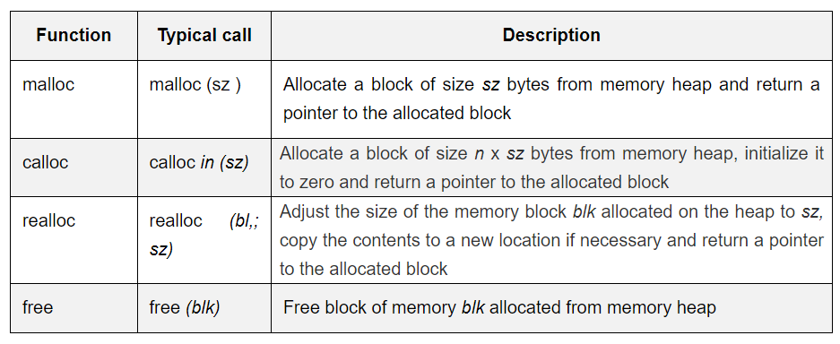
Standard library functions for dynamic memory management

Slide 116
Sparse Matrix
In computer programming, a matrix can be defined with a 2-dimensional array. Any array with 'm' columns and 'n' rows represent a m X n matrix.
There may be a situation in which a matrix contains more number of ZERO values than NON-ZERO values. Such matrix is known as sparse matrix.
Sparse matrix is a matrix which contains very few non-zero elements.
When a sparse matrix is represented with a 2-dimensional array, we waste a lot of space to represent that matrix.
For example, consider a matrix of size 100 X 100 containing only 10 non-zero elements. In this matrix, only 10 spaces are filled with non-zero values and remaining spaces of the matrix are filled with zero.
That means, totally we allocate 100 X 100 X 2 = 20000 bytes of space to store this integer matrix. And to access these 10 non-zero elements we have to make scanning for 10000 times. To make it simple we use the following sparse matrix representation.

Slide 117
Sparse Matrix Representations
In computer programming, a matrix can be defined with a 2-dimensional array. Any array with 'm' columns and 'n' rows represent a m X n matrix.
There may be a situation in which a matrix contains more number of ZERO values than NON-ZERO values. Such matrix is known as sparse matrix.
Sparse matrix is a matrix which contains very few non-zero elements.
When a sparse matrix is represented with a 2-dimensional array, we waste a lot of space to represent that matrix.
For example, consider a matrix of size 100 X 100 containing only 10 non-zero elements. In this matrix, only 10 spaces are filled with non-zero values and remaining spaces of the matrix are filled with zero.
That means, totally we allocate 100 X 100 X 2 = 20000 bytes of space to store this integer matrix. And to access these 10 non-zero elements we have to make scanning for 10000 times. To make it simple we use the following sparse matrix representation.

Slide 118
Sparse Matrix Representations
A sparse matrix can be represented by using TWO representations, those are as follows...
Triplet Representation (Array Representation)
Linked Representation

Slide 119
Sparse Matrix Representations
Triplet Representation (Array Representation)
In this representation, we consider only non-zero values along with their row and column index values.
In this representation, the 0th row stores the total number of rows, total number of columns and the total number of non-zero values in the sparse matrix.
For example, consider a matrix of size 5 X 6 containing 6 number of non-zero values. This matrix can be represented as shown in the image

Slide 120
Sparse Matrix Representations
Triplet Representation (Array Representation)
In above example matrix, there are only 6 non-zero elements ( those are 9, 8, 4, 2, 5 & 2) and matrix size is 5 X 6.
We represent this matrix as shown in the above image. Here the first row in the right side table is filled with values 5, 6 & 6 which indicates that it is a sparse matrix with 5 rows, 6 columns & 6 non-zero values.
The second row is filled with 0, 4, & 9 which indicates the non-zero value 9 is at the 0th-row 4th column in the Sparse matrix.
In the same way, the remaining non-zero values also follow a similar pattern.

Slide 121
Assignment -2
Write a C program to implement the concept of polynomial addition and multiplication using the linked list.
Write a C program to implement the concept of sparse matrix to perform the addition and transpose using the linked list.

Slide 122

THANK YOU

